Slide 1
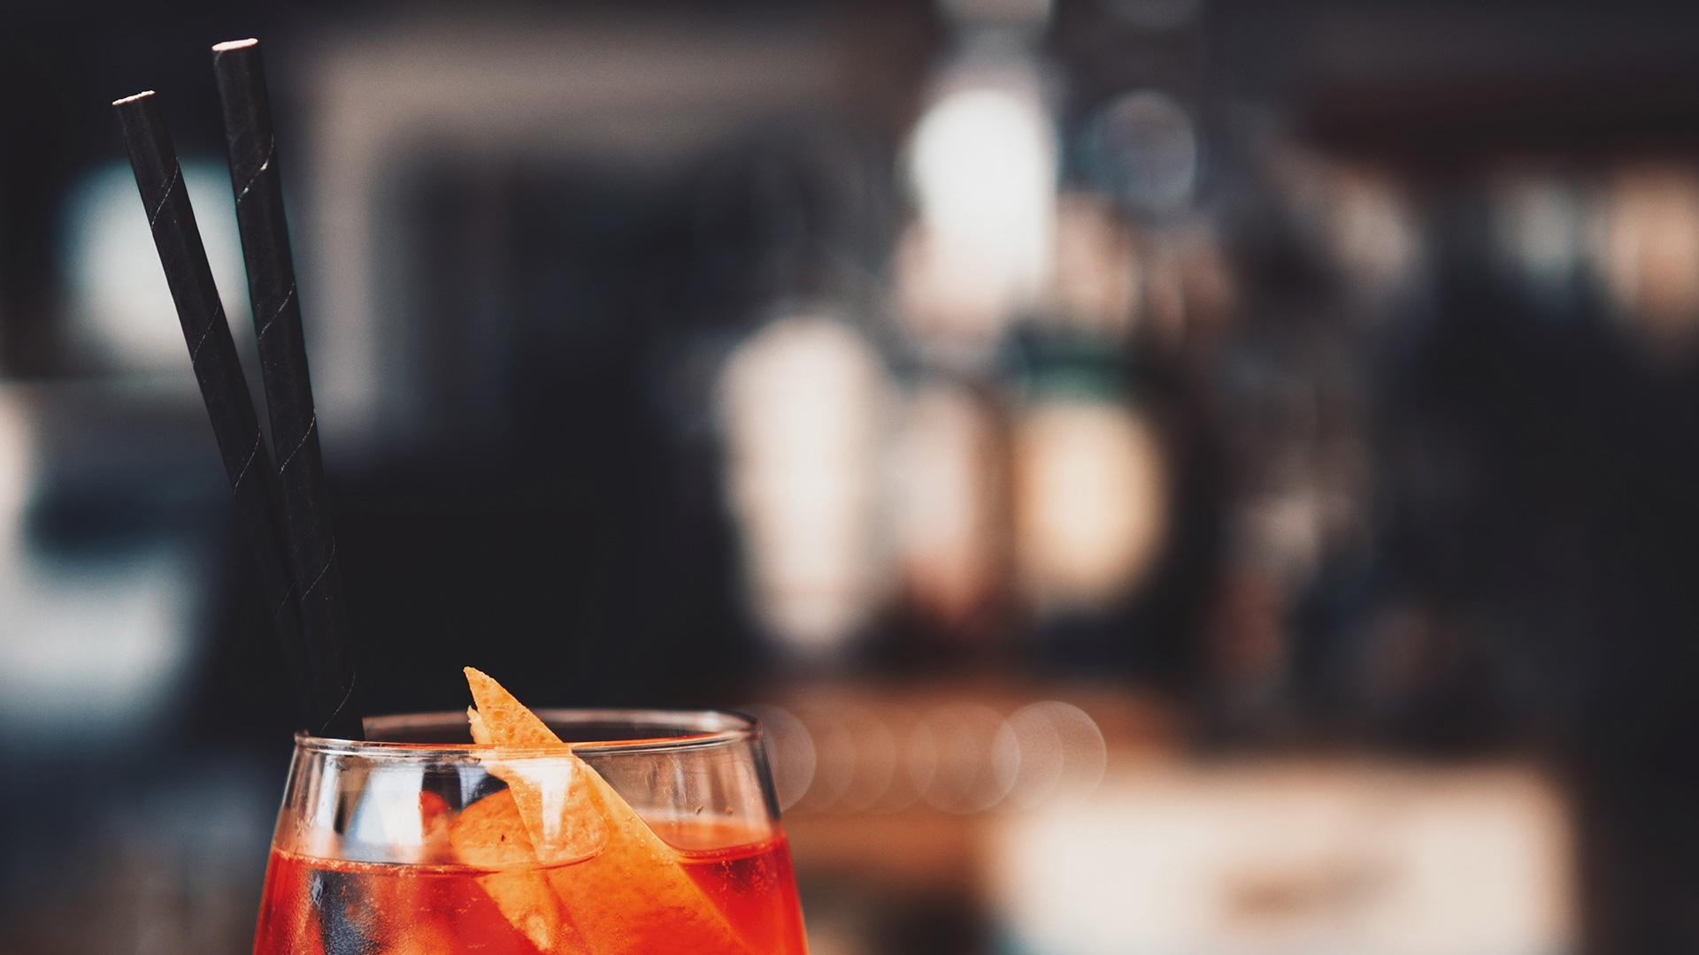
Your foodScanner
It’s a skyscanner, just for food for YOU ☺

Slide 2
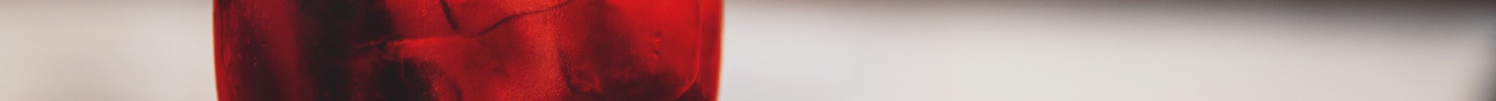
Goals of foodScanner
Here’s what foodScanner hopes to achieve:
Consolidate your favorite eateries from every platform out there to give you the ease of access to all the available and OPEN places at the touch of your finger
Notify you of inhouse and apps related discounts and promotions so that you can compare across platforms easily without having to subscribe to multiple sites
Happy Hour
Ladies Night
Closing hour Discounts
Recommend you eateries based on your preference when you search for a particular type of place to dine

Slide 3
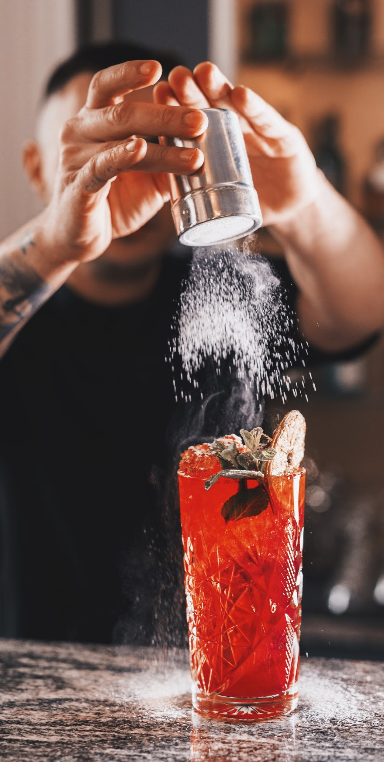
DSI CAPSTONE
Scope
PART 3:
Recommend you eateries based on your preference when you search for a particular type of place to dine
Problem Statement
To create a recommender system to recommend a user personalised places to dine based on their dining history

Slide 4
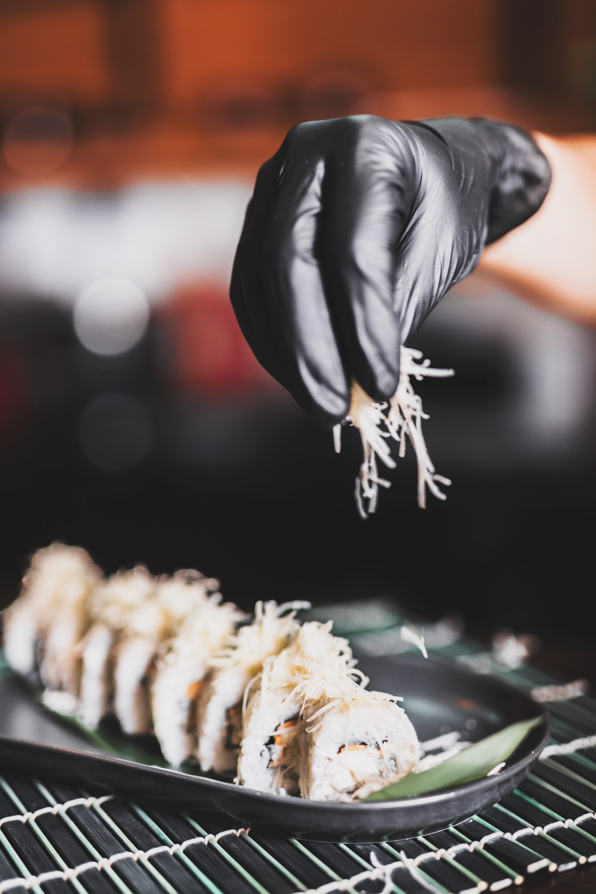
01
EXTRACT, TRANSFORM, LOAD
02
EDA, FEATURE ENGINEERING
03
USER PROFILING
04
PERSONALISED RECOMMENDING
Load in data
Scoping project
Combine Business dataset & Review dataset
Cleaning and Transforming data
Attributes and Categories Expansion & Merge
Dropping columns
Plotting charts to visualise data
Clustering
K-Means
DBSCAN
Hierarchical Clustering
- 3 step recommender methodology

Slide 5
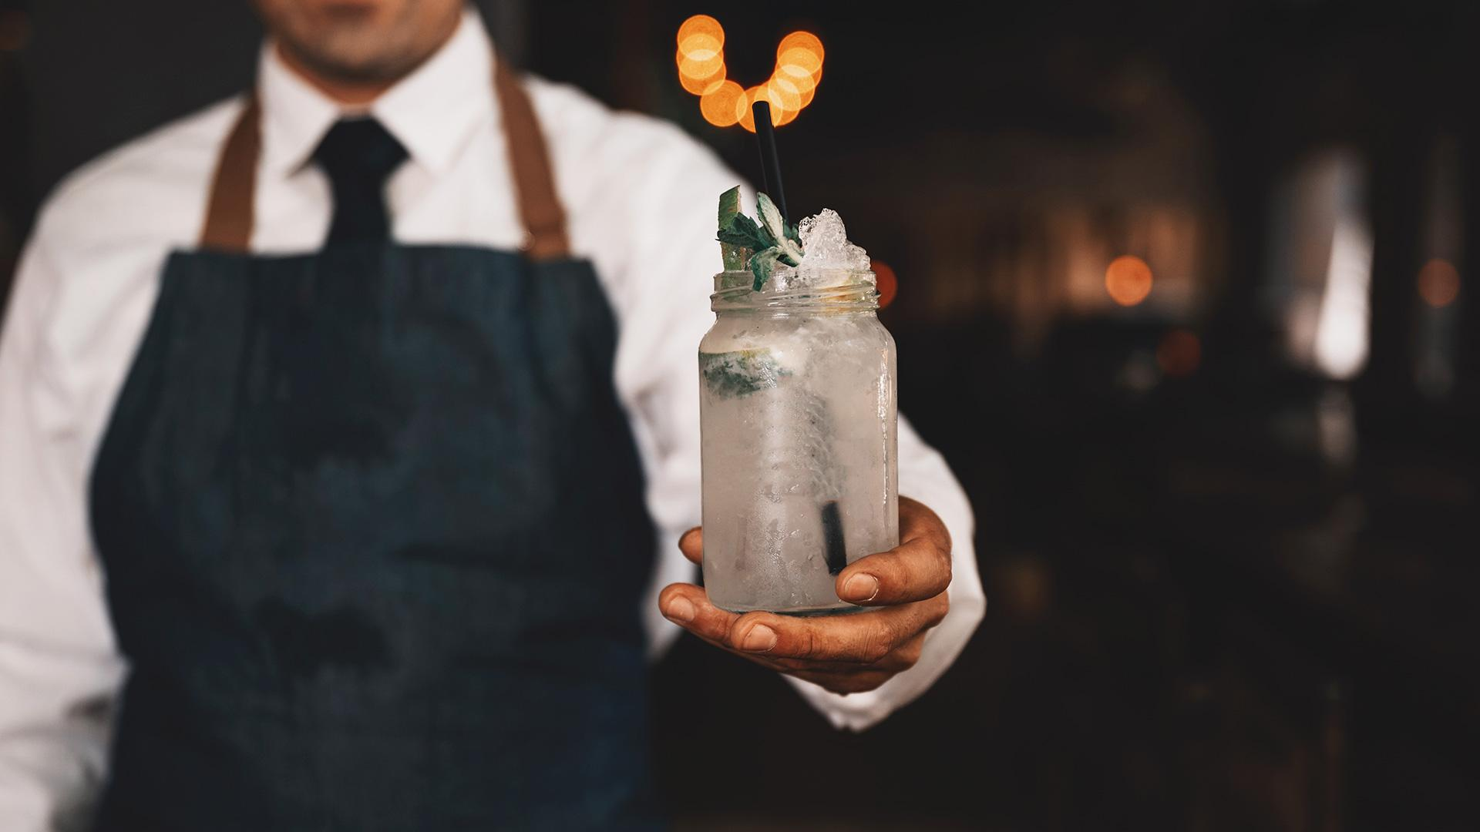
01
THE DATA
YELP DATASET

Slide 6
DATASETS
YELP BUSINESS.json
YELP REVIEWS.json
192,609 --> 7,143 Observations
> 6,000,000 --> 349,535 Observations
14 Variables
9 --> 5 Variables
YELP Reviews Json file contains all the details of all the reviews given to businesses.
Details include:
Review ID, User ID, Business ID
Date of review and Content of review
Star given to business by user
YELP Business Json file contains all the details of all the businesses in USA and in Canada.
Details include:
City, State, Address, Geographical Coordinates
Attributes of businesses
GoodForKids/ NoiseLevel/ ByAppointmentOnly
Type of business
Food/ Health & Medical/ Home Services/ Shopping etc

Slide 7
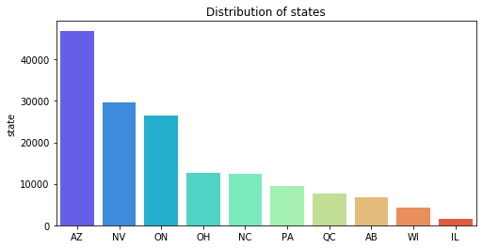
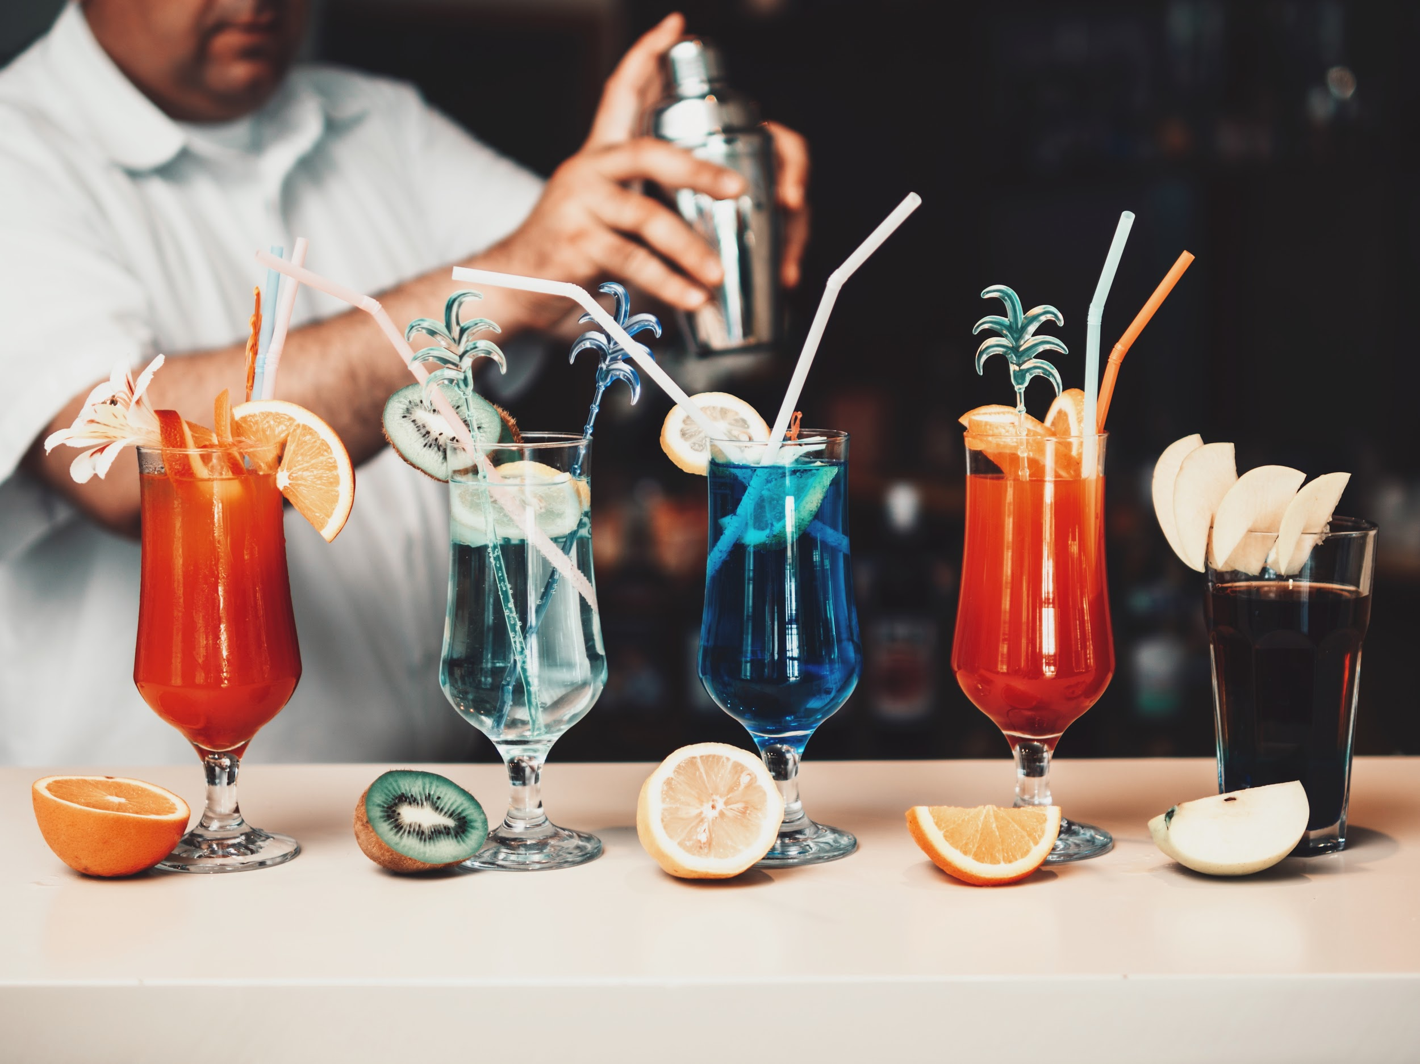
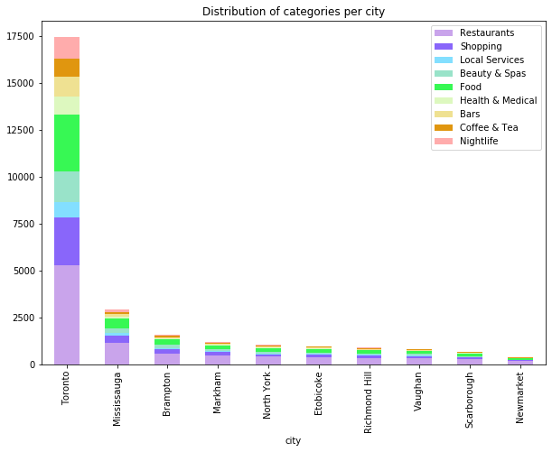
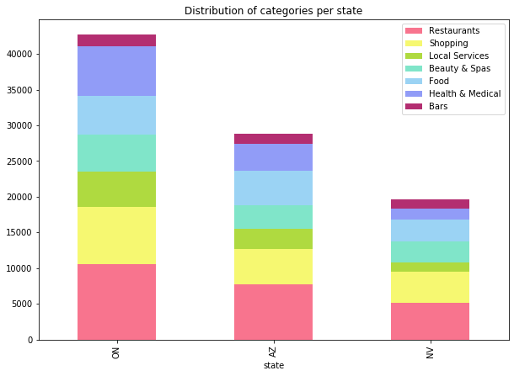
EXTRACT, TRANSFORM, LOAD
Scoping Project
Toronto, Canada

Slide 8
EXTRACT, TRANSFORM, LOAD
Scoping Project
Toronto, Canada
Businesses with dining related categories
Dining related categories in top 30 categories for Toronto
-----------------------------
'Restaurants |Food |Bars |Coffee & Tea |Specialty Food |Sandwiches |Cafes |Breakfast & Brunch |Fast Food |Chinese |Pizza |Bakeries |Canadian (New) |Desserts |Italian'

Slide 9
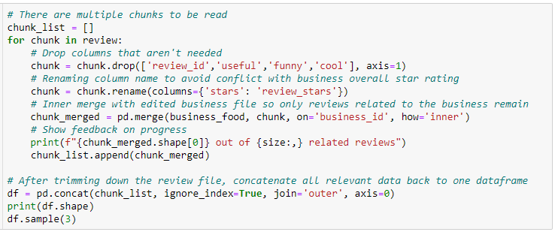
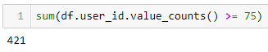
EXTRACT, TRANSFORM, LOAD
Scoping Project
Combine Business & Reviews
Toronto, Canada
Businesses with dining related categories
User ID, review stars, text and date of review
Keep users with > 75 reviews

Slide 10
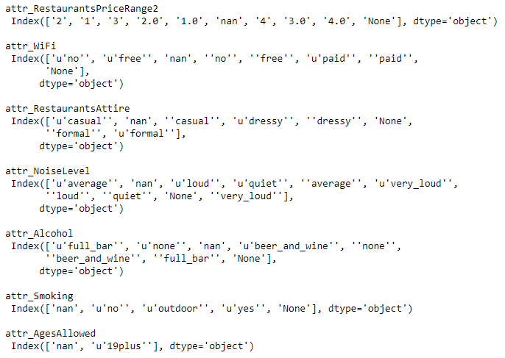
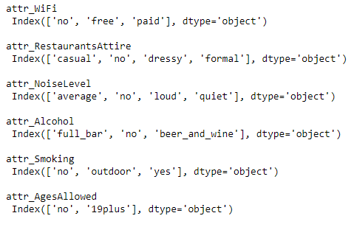
EXTRACT, TRANSFORM, LOAD
Scoping Project
Combine Business & Reviews
Transform & Clean data
Toronto, Canada
Businesses with dining related categories
User ID, review stars, text and date of review
Keep users with > 75 reviews
Remove unnecessary columns
Changing datatypes of columns

Slide 11
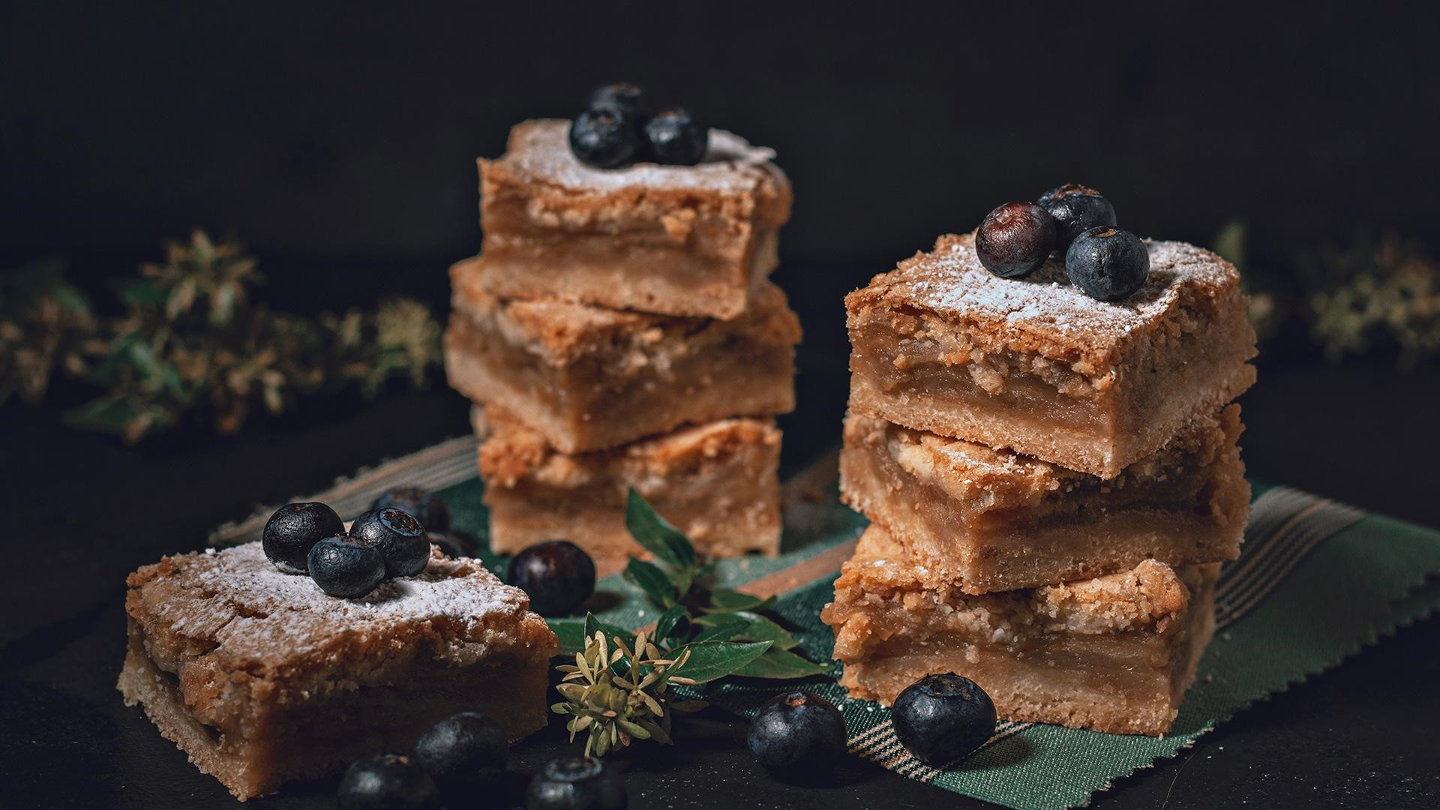
02
EXPLOSION
CATEGORIES & ATTRIBUTES

Slide 12
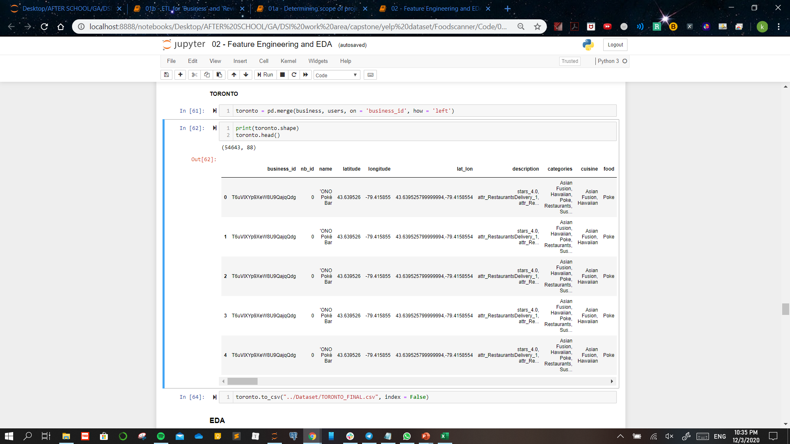
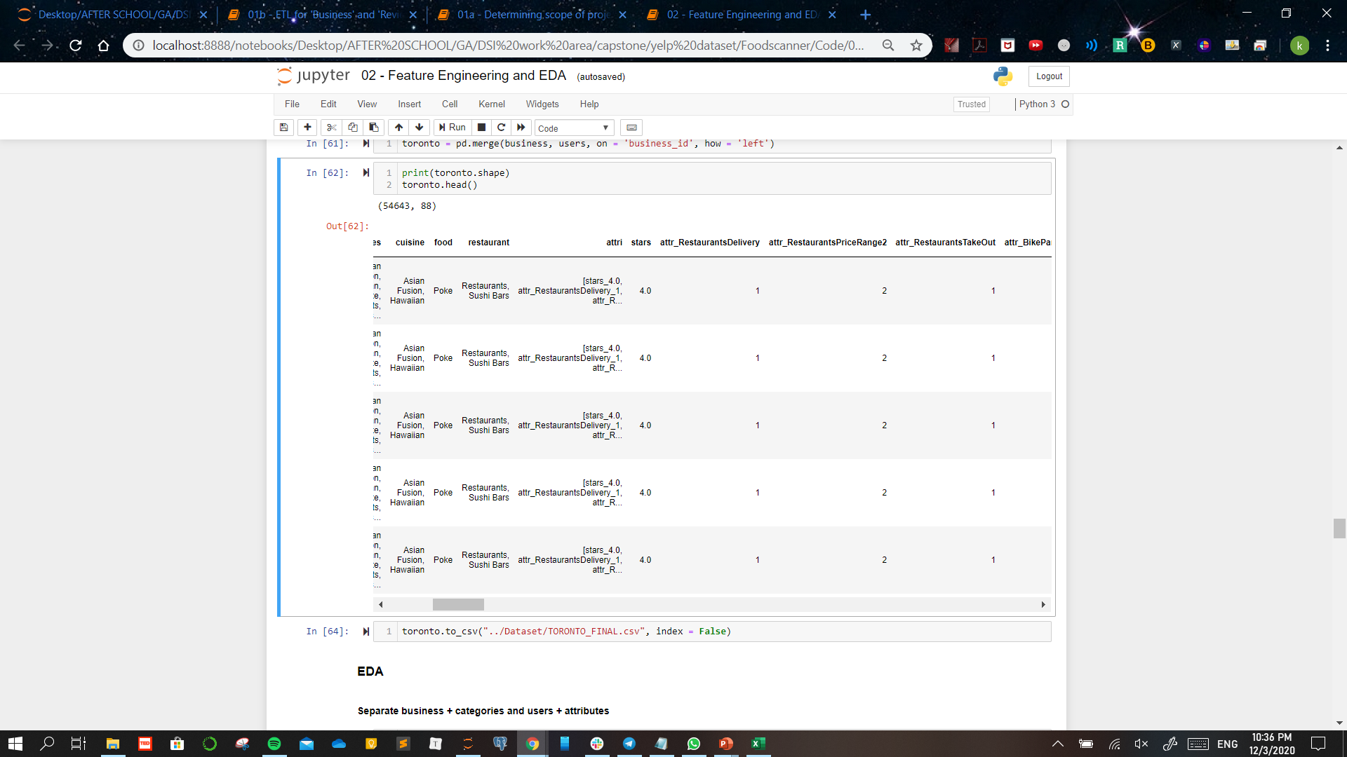
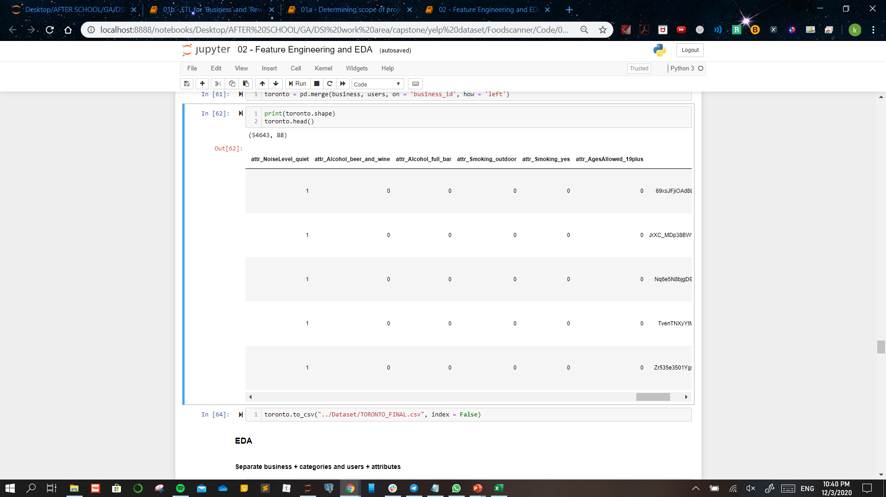
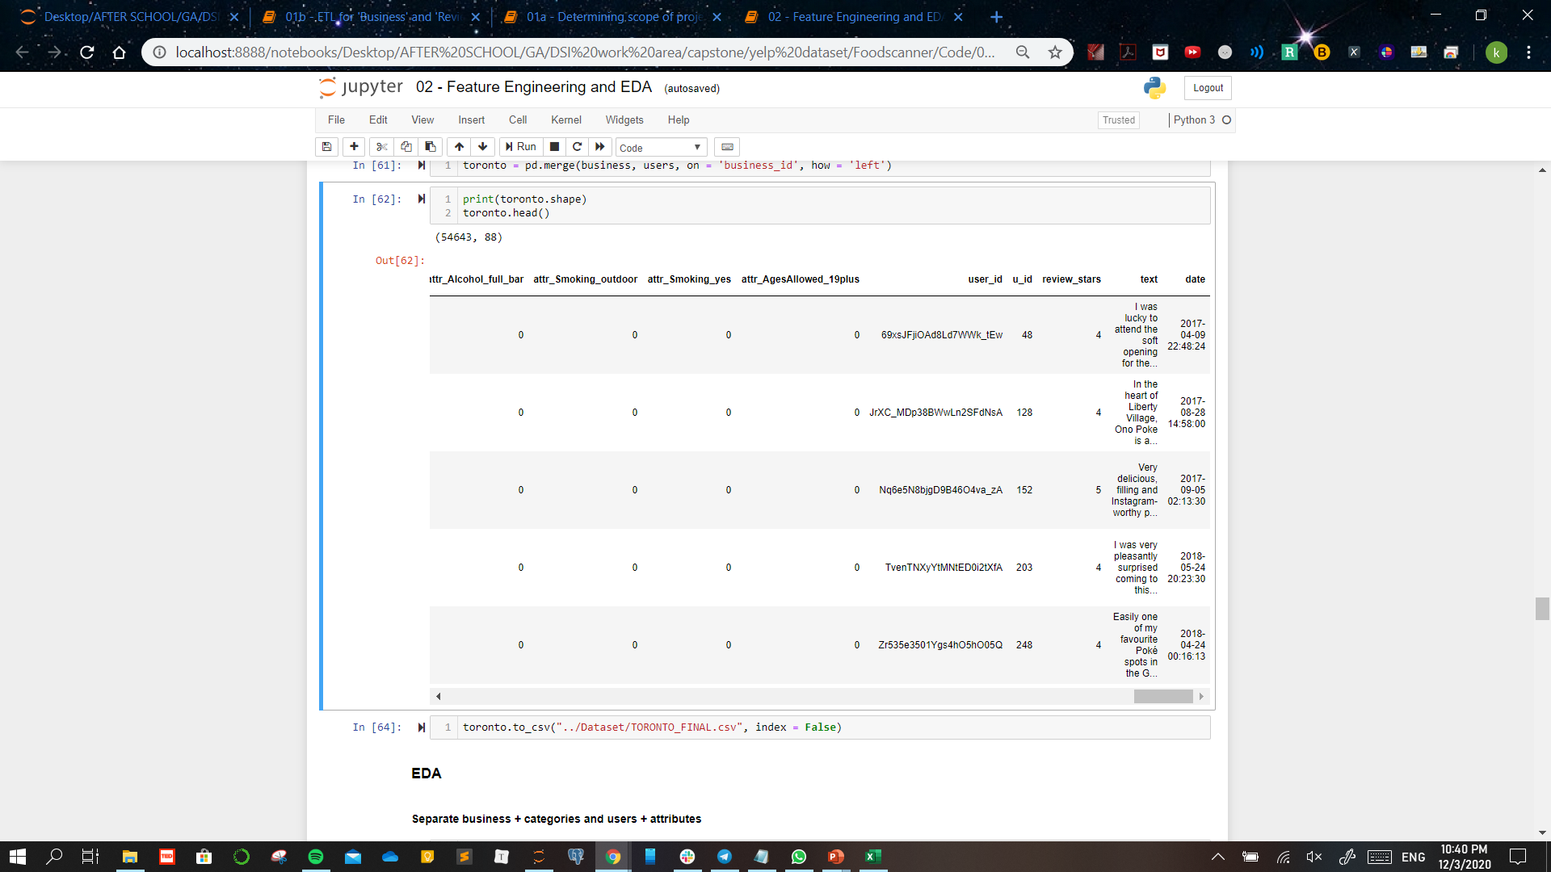
TORONTO DATAFRAME
....
Numerical index ‘nb_id’ given for every business_id for ease of recognition
‘description’ column created to combine categories and attributes
Business

Slide 13
TORONTO DATAFRAME
....
Categories column expanded to create separate ‘cuisine’, ‘food’ and ‘restaurant’ columns
Categories

Slide 14
TORONTO DATAFRAME
....
Attributes column expanded to create numerical attributes columns
New ‘attri’ column created with only the attributes the business contains
....
Attributes

Slide 15
TORONTO DATAFRAME
....
Numerical index ‘u_id’ given for every user_id for ease of recognition
Users + Reviews

Slide 16
Attributes
Categories
....
Attributes describe the features of the businesses
Categories describe the food available, the cuisine and the type of dining
Extract all unique keys of dictionary
Expand embedded dictionaries
Key-list
1 / 0
{ }
attr_x
Loop through every key to expand attributes to multiple columns
One-Hot Encode attribute variables

Slide 17
Attributes
Categories
....
Attributes describe the features of the businesses
Categories describe the food available, the cuisine and the type of dining
Explode categories column
Keep only cleaned columns and merge back to dataframe
| | | |
Separate columns into ‘Cuisine’, ‘Food’ and ‘Restaurant’

Slide 18
User - Attributes
Business - Categories
....
Attributes describe the features of the businesses
User-attributes extracted to profile users based on the features they look for in a dining venue
This serves as an alternate means of collaborative filtering
Categories describe the food available, the cuisine and the type of dining
Categories to be fit into a matrix and similar eateries to be filtered using a similarity means (cosine similarity)
This would be a content based filtering
Hybrid Recommendation

Slide 19
Exploratory Data Analysis
Popular Categories
Trending Attributes
Bike Parking
Restaurants Take Out
Restaurant Attire: Casual
Good For Groups
46432
Speciality Food, Canadian (New), Chinese
CUISINE
44990
Coffee & Tea, Breakfast & Brunch, Sandwiches
39485
FOOD
36642
Bars, Cafes, Bakeries
Price Range : 2
35595
RESTAURANT

Slide 20
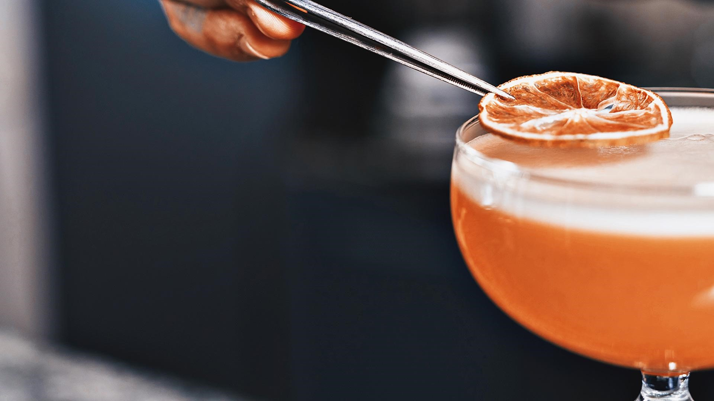
03
CLUSTERING
K-MEANS DBSCAN
HIERARCHICAL

Slide 21
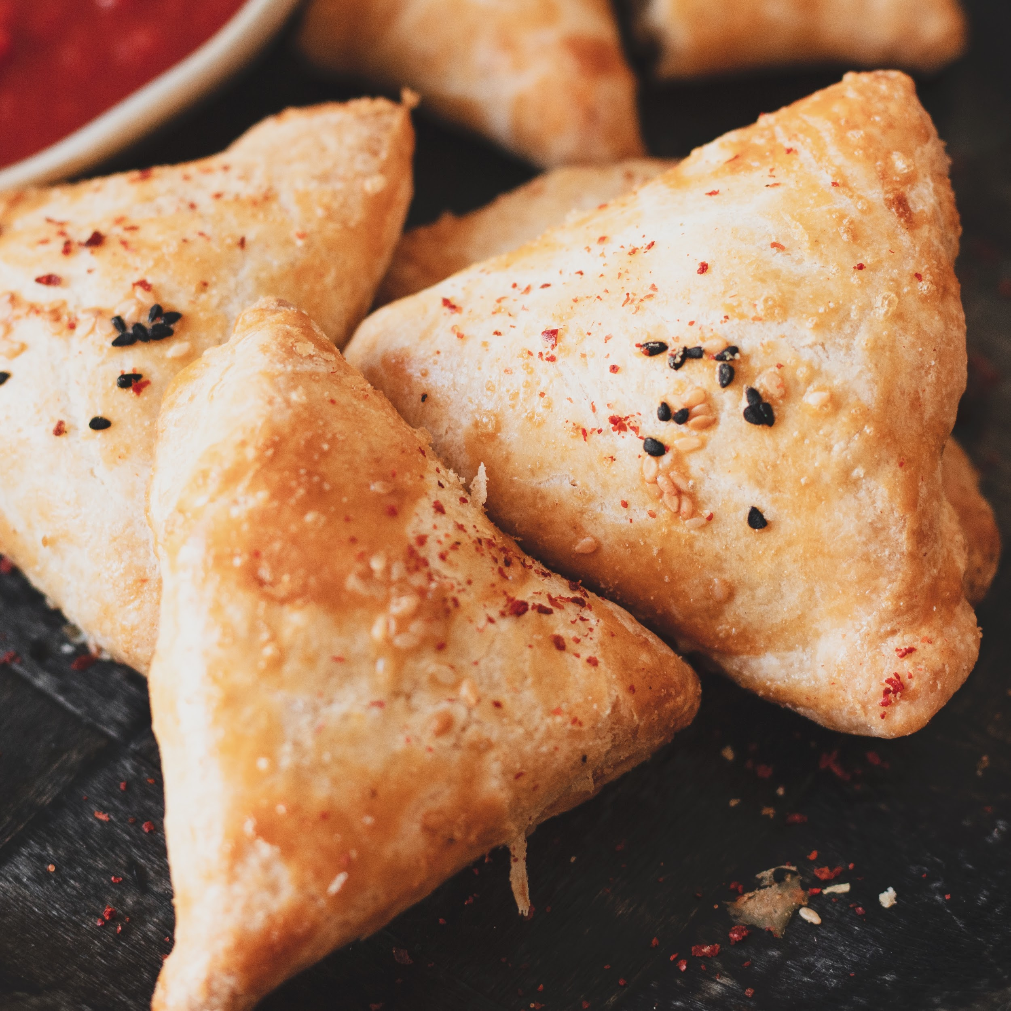
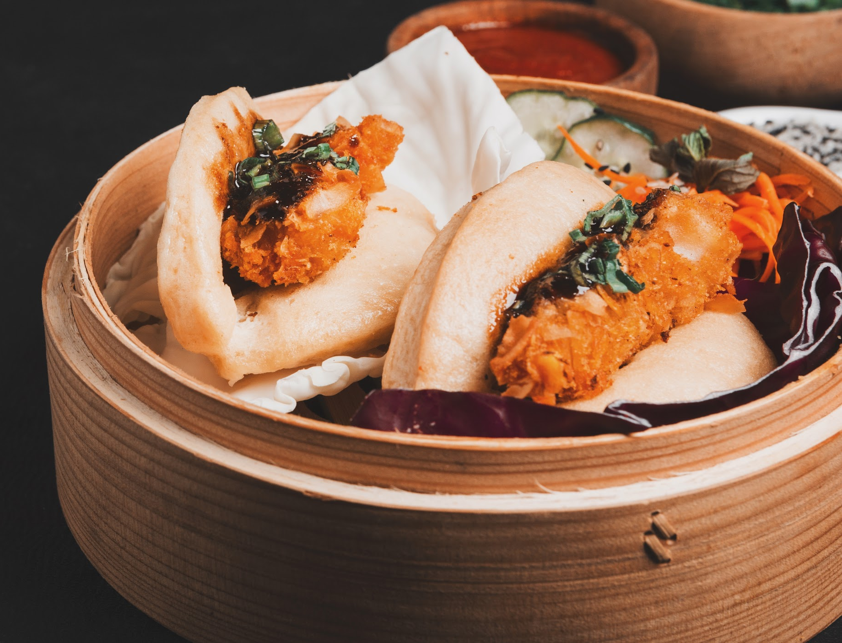
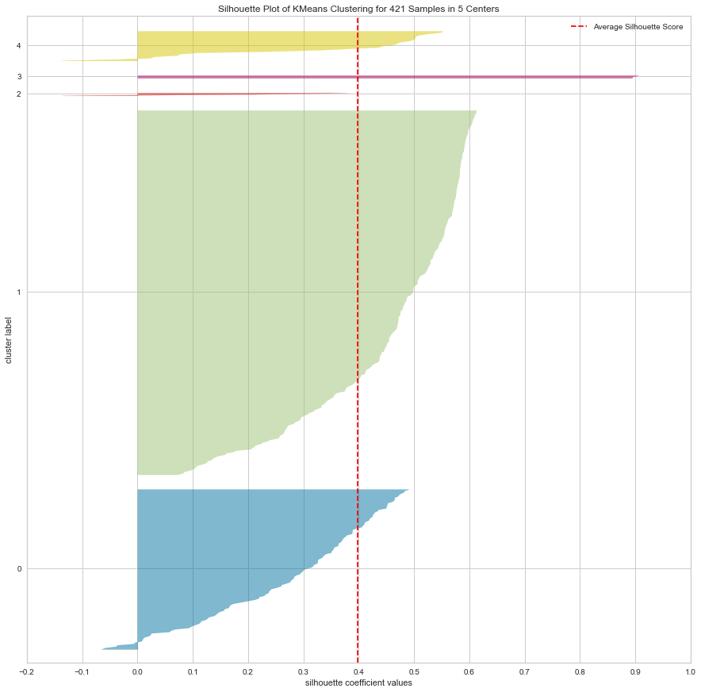
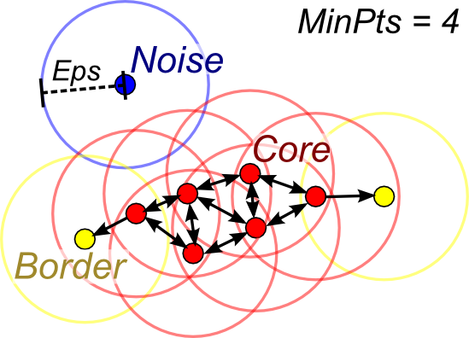
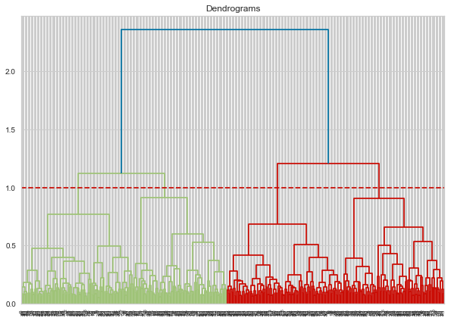
USER PROFILING: CLUSTERING
K-Means
DBSCAN
Hierarchical Clustering
Initiated K: 5
Silhouette score: 0.398
Ideal K: 2
Silhouette score for ideal K: 0.639
Ideal to use when data points are very near each other
Ideal K: 3
Silhouette score: 0.307
No. of outliers: 54
When cut at threshold of 1,
No. of clusters obtained: 4
~ 100 users per cluster
Notes:
The way kmeans algorithm works is as follows:
Specify number of clusters K.
Initialize centroids by first shuffling the dataset and then randomly selecting K data points for the centroids without replacement.
Keep iterating until there is no change to the centroids. i.e assignment of data points to clusters isn’t changing.
Compute the sum of the squared distance between data points and all centroids.
Assign each data point to the closest cluster (centroid).
Compute the centroids for the clusters by taking the average of the all data points that belong to each cluster.

Slide 22
USER PROFILING: CLUSTERING
Clusters achieved via Hierarchical clustering will be used for User profiling due to the clusters being uniformly segregated
K-Means
DBSCAN
Hierarchical Clustering
Initiated K: 5
Silhouette score: 0.398
Ideal K: 2
Silhouette score for ideal K: 0.639
Ideal to use when data points are very near each other
Ideal K: 3
Silhouette score: 0.307
No. of outliers: 54
When cut at threshold of 1,
No. of clusters obtained: 4
~ 100 users per cluster
Notes:
The way kmeans algorithm works is as follows:
Specify number of clusters K.
Initialize centroids by first shuffling the dataset and then randomly selecting K data points for the centroids without replacement.
Keep iterating until there is no change to the centroids. i.e assignment of data points to clusters isn’t changing.
Compute the sum of the squared distance between data points and all centroids.
Assign each data point to the closest cluster (centroid).
Compute the centroids for the clusters by taking the average of the all data points that belong to each cluster.

Slide 23
User Profile Clusters
User X
Bike Parking
Restaurant allows take Out
Restaurant allows take out
...
Good for Groups
Restaurant attire: Casual
Bike Parking
Restaurant attire: Casual
...
Good for Kids
Good for Groups
CLUSTER
01
CLUSTER
04
CLUSTER
03
CLUSTER
02

Slide 24
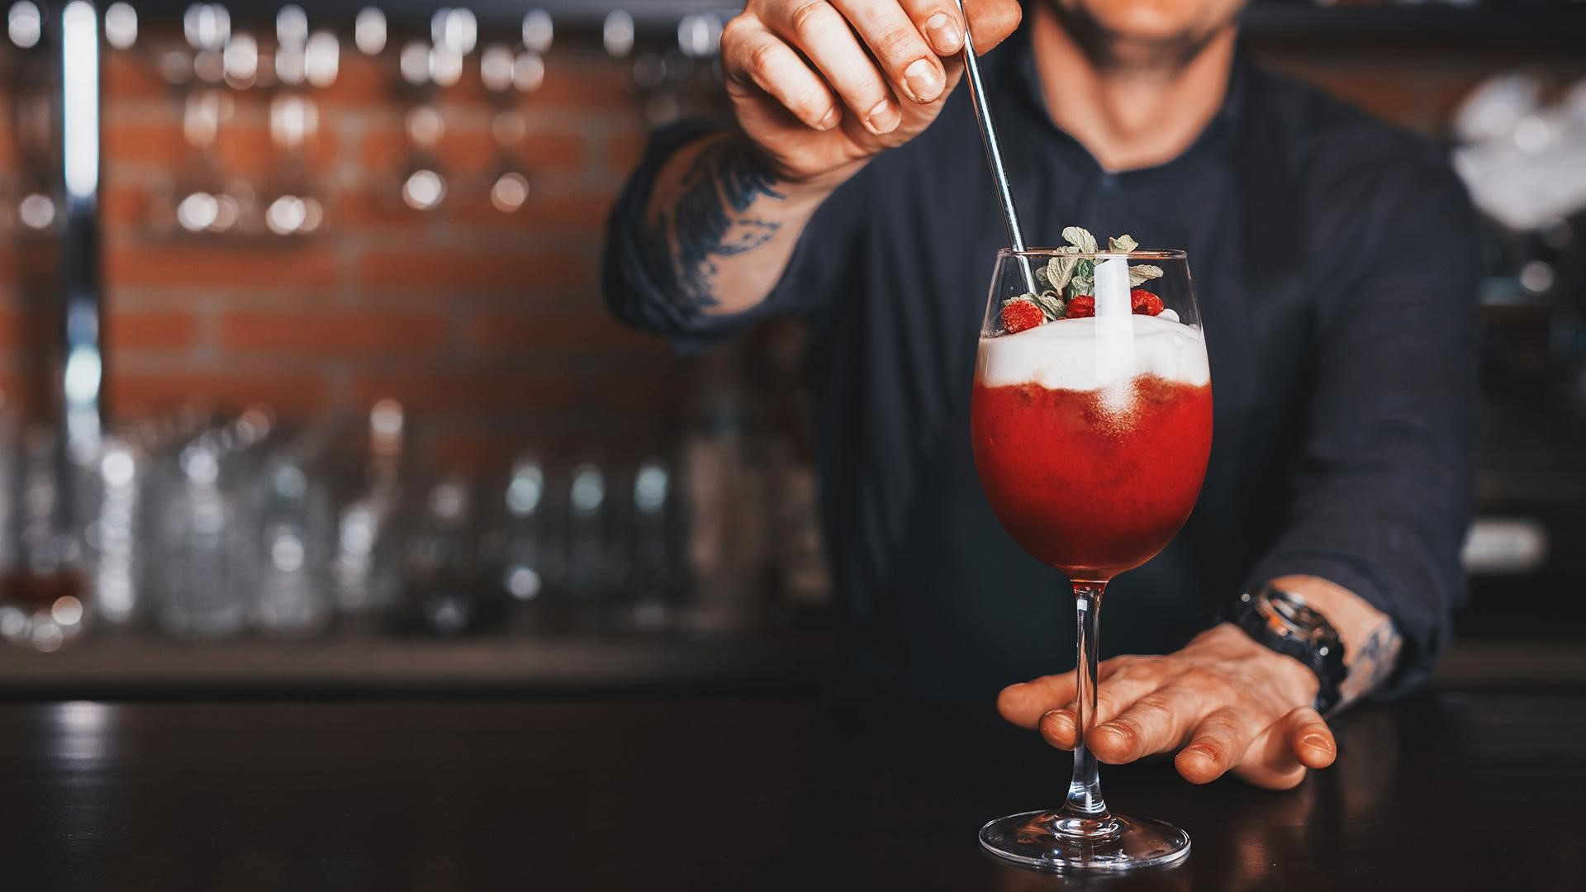
04
Personal Recommendation

Slide 25
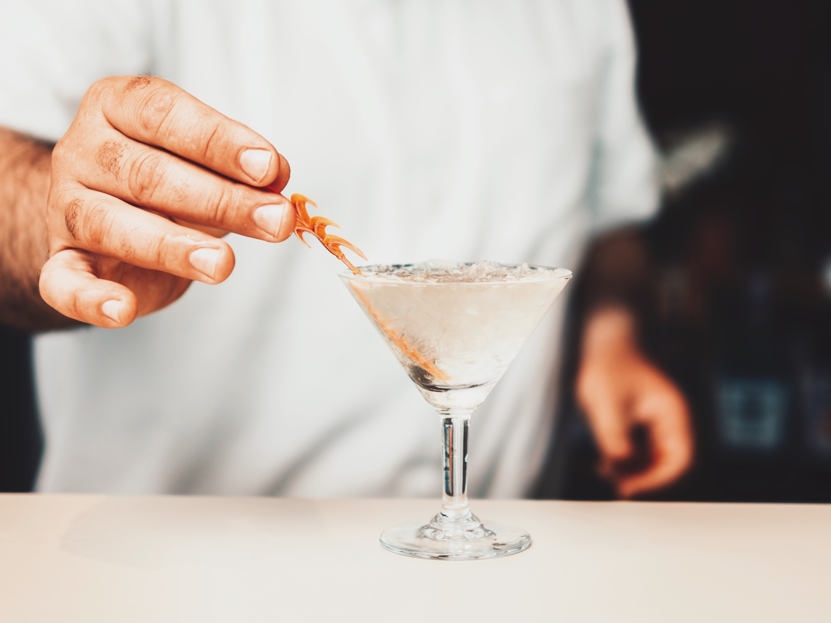
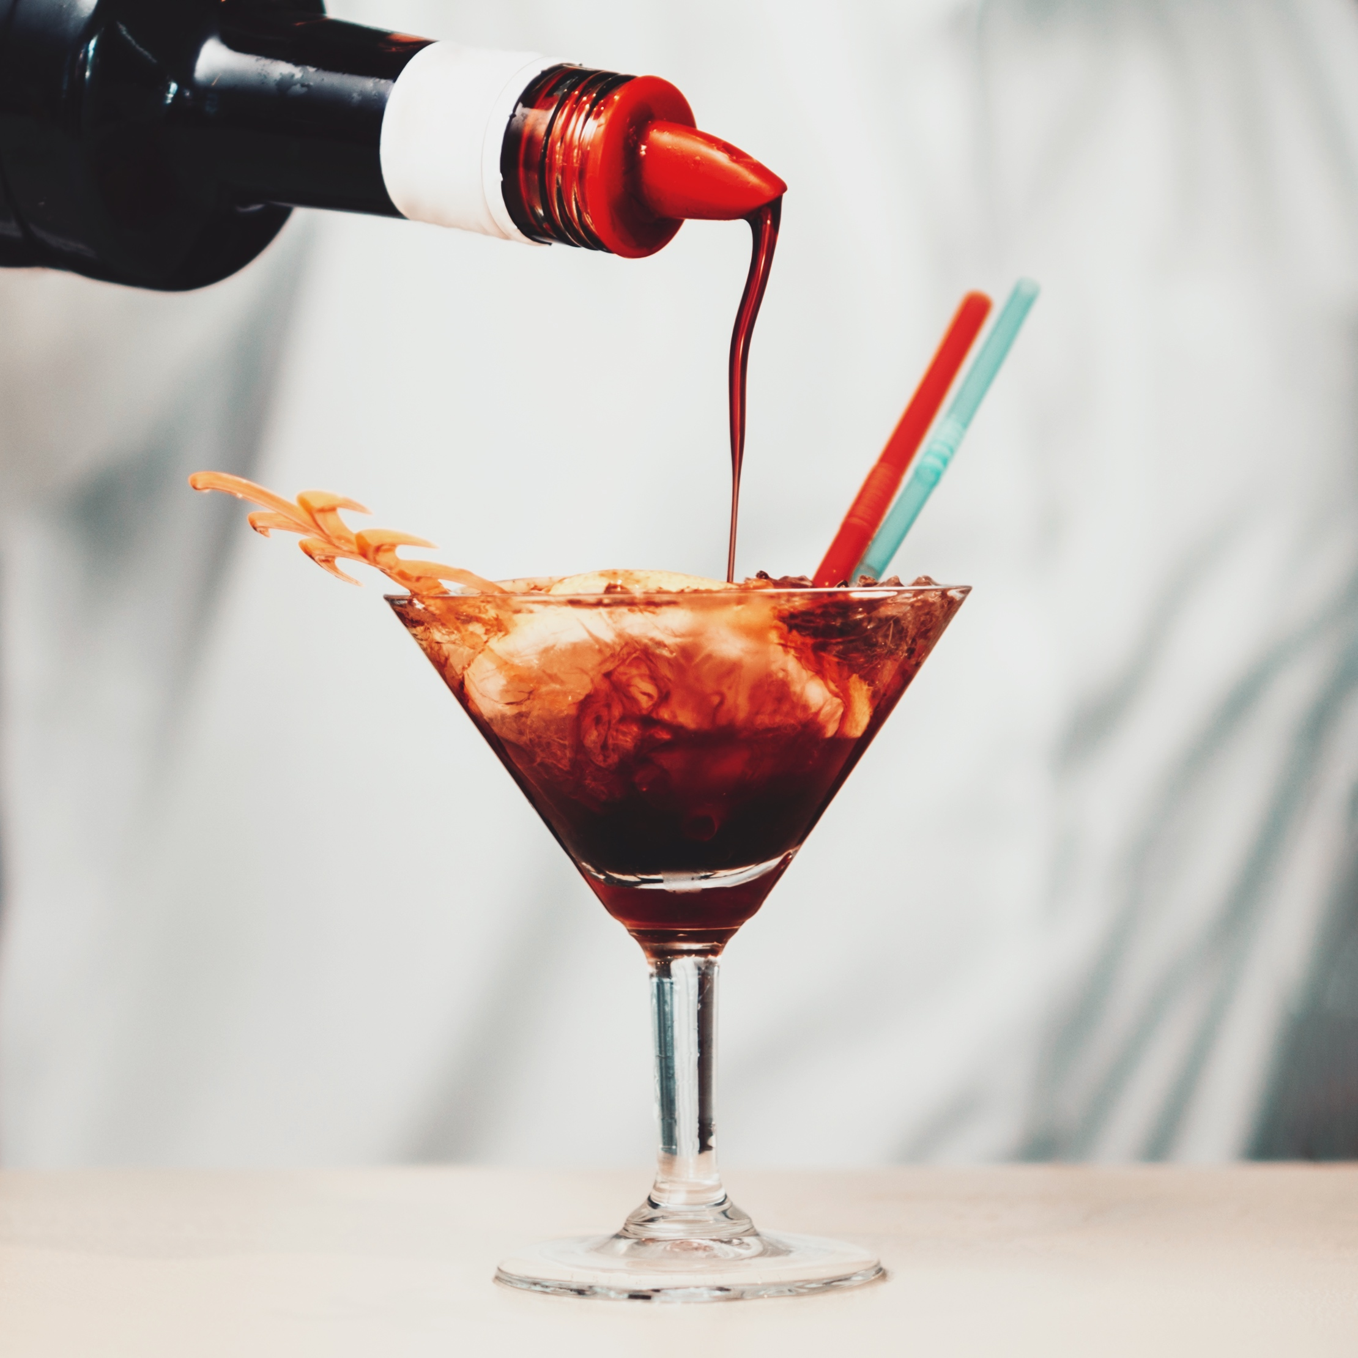
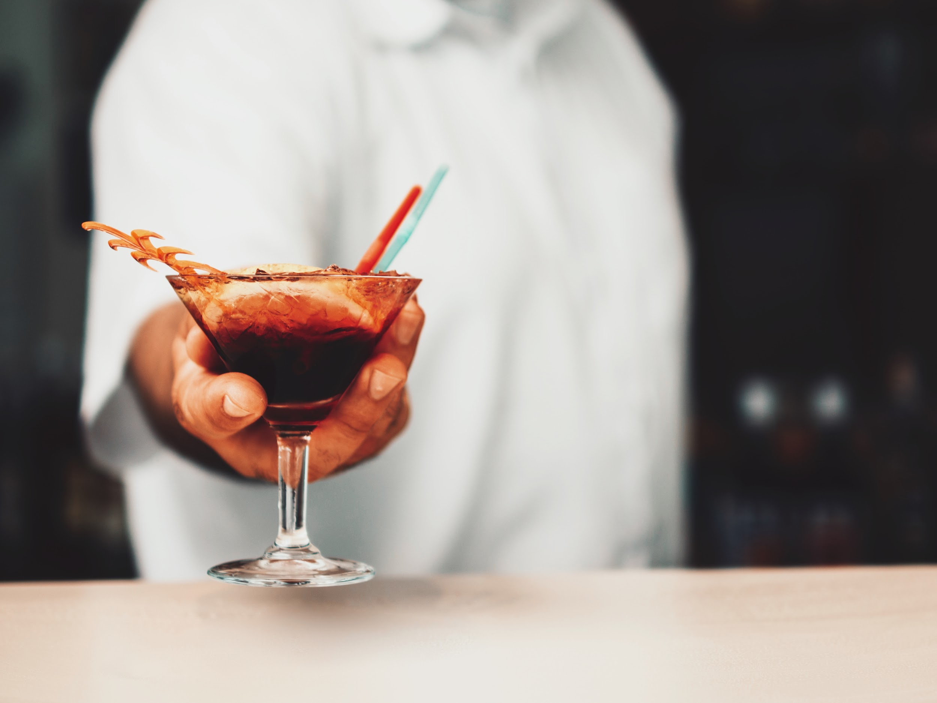
RECOMMENDER METHODOLOGY
01
02
03
For a particular user x, find the attribute cluster user x is in
Find all the eateries suited to user x based on cluster
- Attributes filtering
Use content based filtering to find similar eateries for user x
- Categories filtering

Slide 26
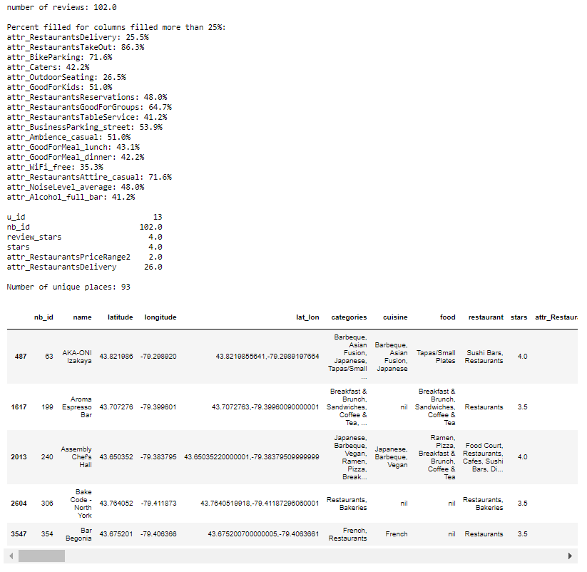
RECOMMENDER METHODOLOGY
01
For a particular user x, find the attribute cluster user x is in
Eg. User 13

Slide 27
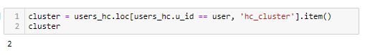
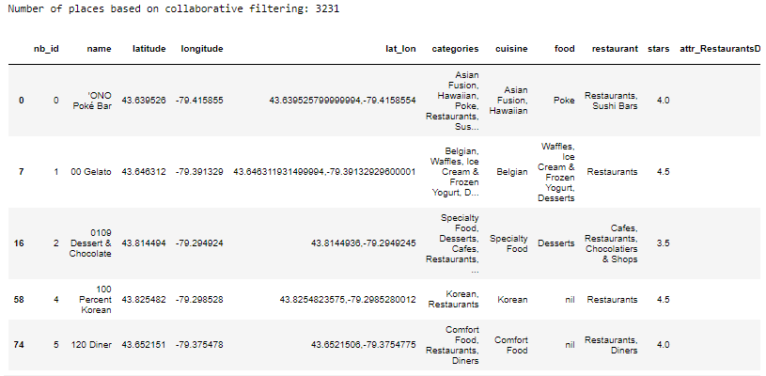
RECOMMENDER METHODOLOGY
02
Find all the eateries suited to user x based on cluster
- Attributes filtering

Slide 28
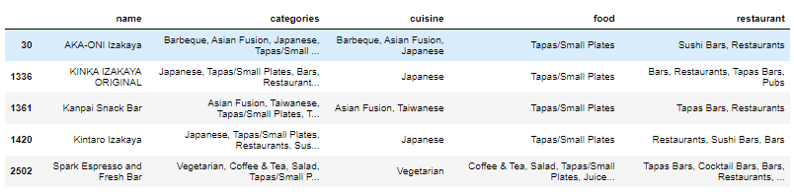
RECOMMENDER METHODOLOGY
Step 1:
Generate list of businesses that user 13 have previously visited
Step 2:
CountVectorize ‘Categories’ column of businesses in cluster 2
Step 3:
Generate cv matrix and calculate cosine similarity
Step 4:
Comparing cosine similarity, recommend similar restaurants as those previously visited by user 13
03
Use content based filtering to find similar eateries for user x
- Categories filtering

Slide 29
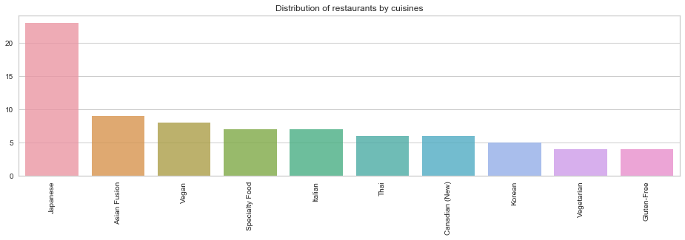
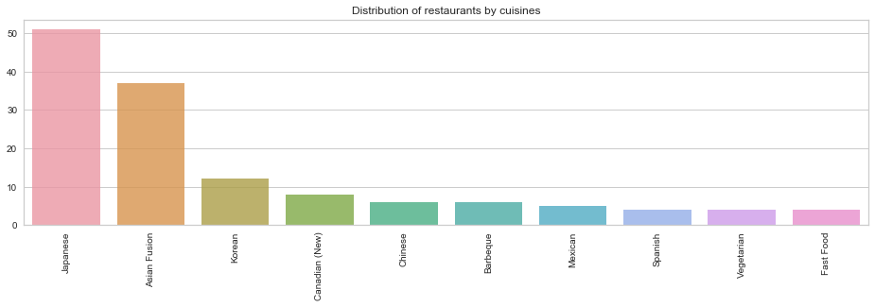
EVALUATING RECOMMENDER
User 13 history
User 13 Rec
23 | Japanese
09 | Asian Fusion
08 | Vegan
07 | Speciality Food
07 | Italian
Cuisine
51 | Japanese
37 | Asian Fusion
12 | Korean
08 | Canadian (New)
06 | Chinese

Slide 30
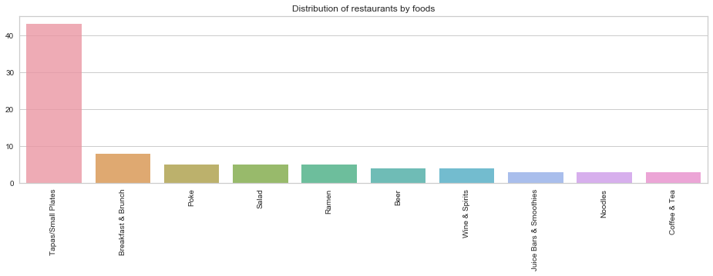
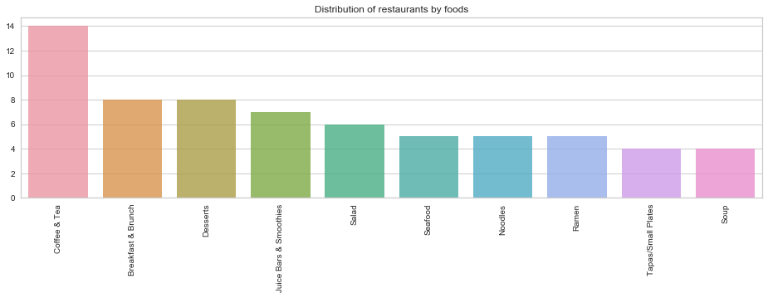
EVALUATING RECOMMENDER
User 13 history
User 13 Rec
14 | Coffee & Tea
08 | Breakfast & Brunch
08 | Desserts
07 | Juice Bars & Smoothies
06 | Salad
Food
43 | Tapas/Small Plates
37 | Breakfast & Brunch
12 | Poke
08 | Salad
06 | Ramen

Slide 31
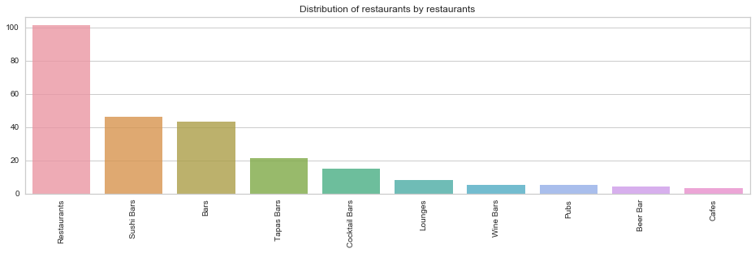
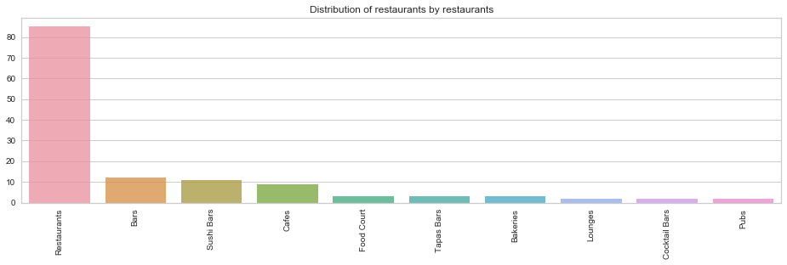
EVALUATING RECOMMENDER
User 13 history
User 13 Rec
85 | Restaurants
12 | Bars
11 | Sushi Bars
09 | Cafes
03 | Food Court
Restaurant
101 | Restaurants
46 | Sushi Bars
43 | Bars
21 | Tapas Bars
06 | Cocktail Bars

Slide 32
EVALUATING RECOMMENDER
Filter: Japanese (cuisine)
Filter: Breakfast & Brunch (food)
Filter: Sushi Bars (restaurant)
 | Tapas/Small Plates
 | Seafood
 | Ramen
 | Breakfast & Brunch
 | Desserts, Salad
 | Restaurants, Bars, Sushi Bars
 | Lounges, Wine Bars, Cocktail Bars, Bar
 | Sushi Bars, Restaurants
 | Bars, Restaurants
 | Wine Bars, Bars, Cocktail Bars
 | Poke
 | Seafood
 | Salad
 | Breakfast & Brunch
 | Tapas/ Small Plates

Slide 33
EVALUATING RECOMMENDER
User 13 history
User 13 Rec
14 | Coffee & Tea
08 | Breakfast & Brunch
08 | Desserts
07 | Juice Bars & Smoothies
06 | Salad
Food
43 | Tapas/Small Plates
37 | Breakfast & Brunch
12 | Poke
08 | Salad
06 | Ramen

Slide 34
EVALUATING RECOMMENDER
Filter: Japanese (cuisine)
Filter: Breakfast & Brunch (food)
Filter: Sushi Bars (restaurant)
 | Tapas/Small Plates
 | Seafood
 | Ramen
 | Breakfast & Brunch
 | Desserts, Salad
 | Restaurants, Bars, Sushi Bars
 | Lounges, Wine Bars, Cocktail Bars, Bar
 | Sushi Bars, Restaurants
 | Bars, Restaurants
 | Wine Bars, Bars, Cocktail Bars
 | Poke
 | Seafood
 | Salad
 | Breakfast & Brunch
 | Tapas/ Small Plates

Slide 35
EVALUATING RECOMMENDER
User 13 history
User 13 Rec
85 | Restaurants
12 | Bars
11 | Sushi Bars
09 | Cafes
03 | Food Court
Restaurant
101 | Restaurants
46 | Sushi Bars
43 | Bars
21 | Tapas Bars
06 | Cocktail Bars

Slide 36
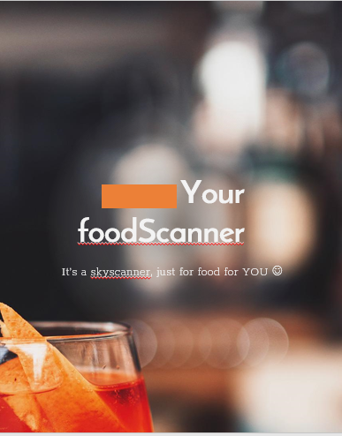
FUTURE WORKS
Deployment
Aim is to take in user input and to filter from recommendation
Inputs to consider:
Location of user (to filter by location)
Time of day during usage
User input of categories or attributes
foodScanner webpage
foodScanner mobile app

Slide 37
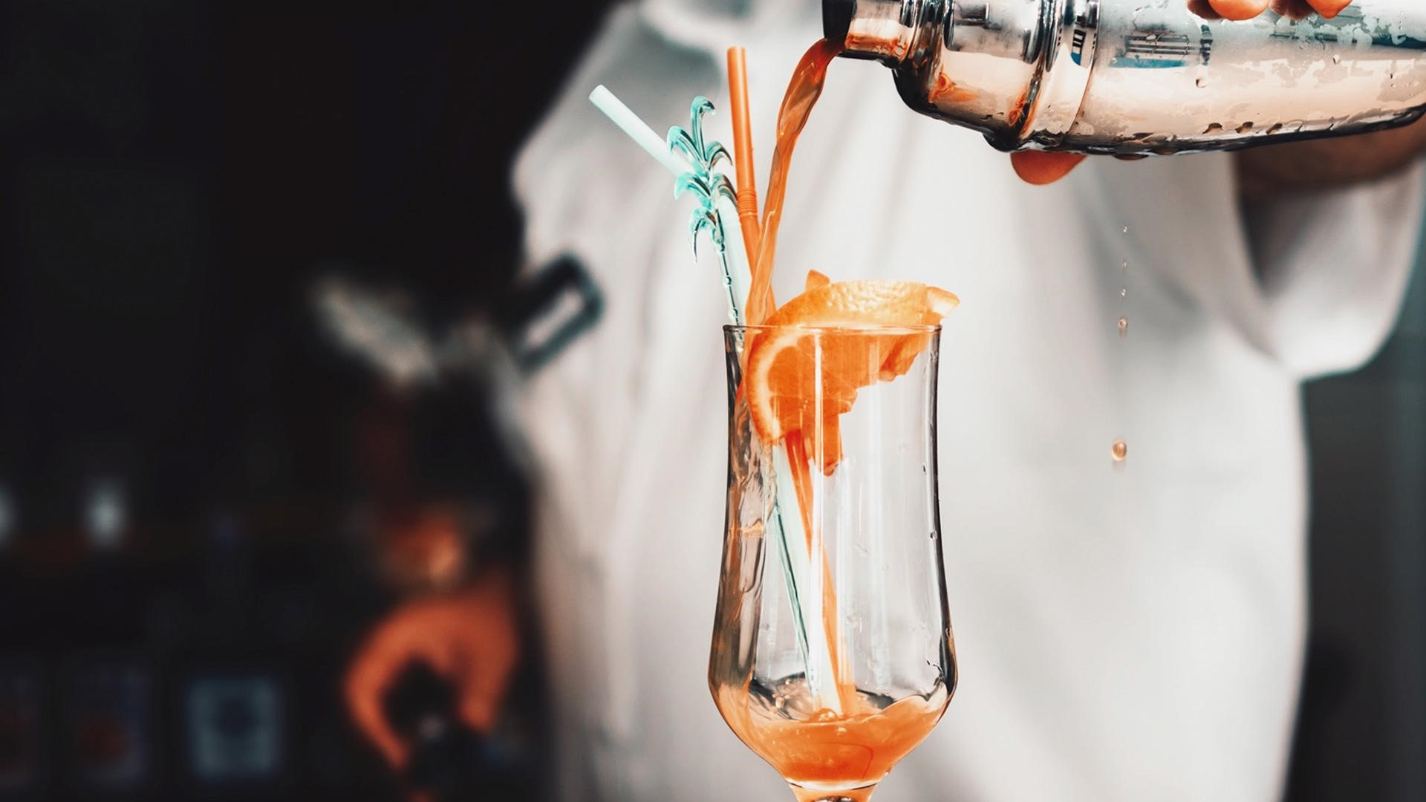
Thank You

